Slide 1
Pre digitization
Brenda Nyaboke
Expert Workshop on GBIF Data Publication in Africa, 12.10.2023

Slide 2
What is a digitization workﬂow?
“a sequence of tasks that are performed in order to create digital information that characterised individual specimens” (Nelson et al. 2012)
Brenda Nyaboke, Expert Workshop on GBIF Data Publication in Africa, ITCER, Kenya, 12.10.2023

Slide 3
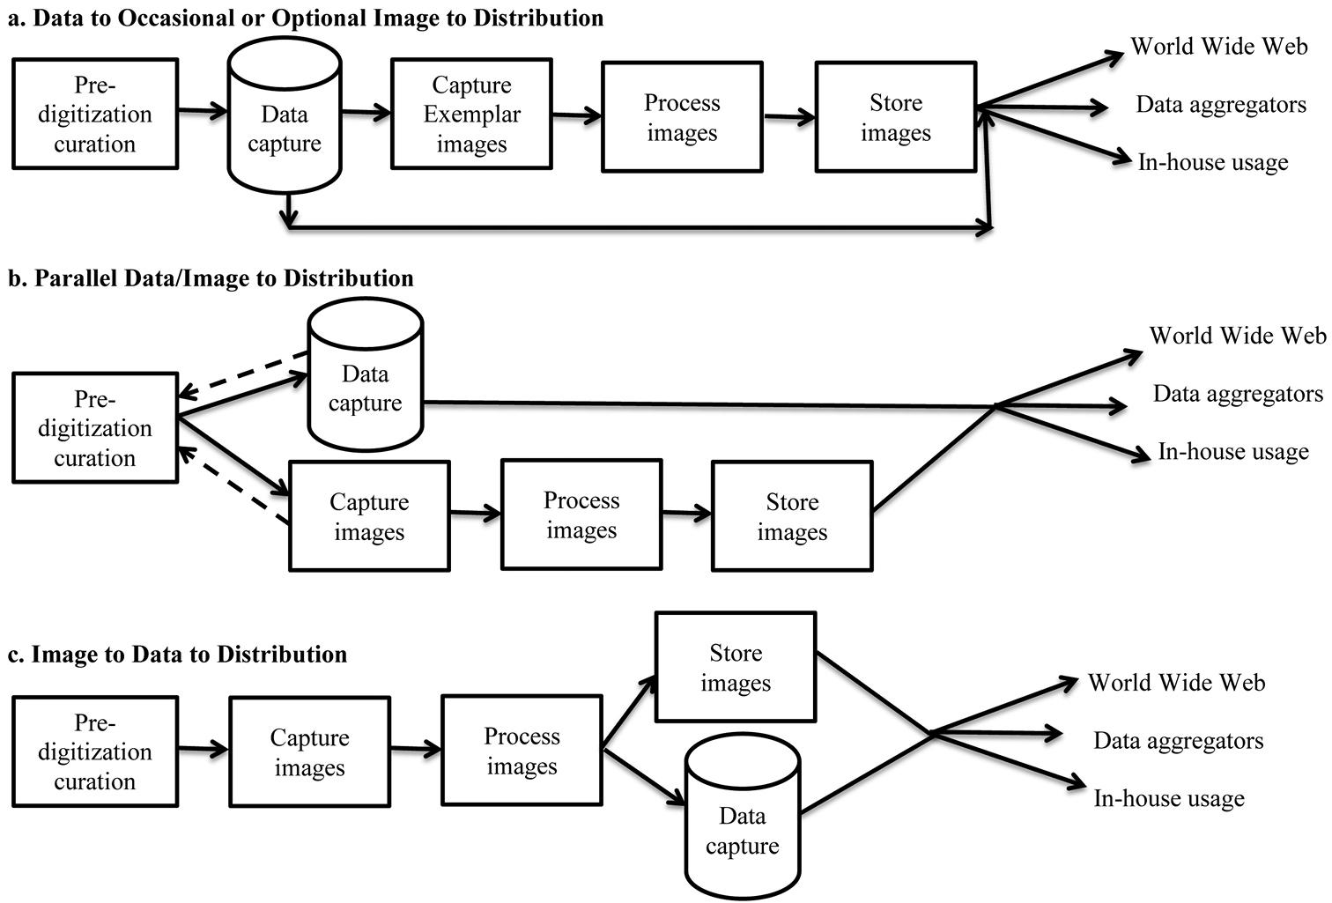
Figure 1 in Nelson G, Paul D, Riccardi G, Mast A. 2012. Five task clusters that enable eﬃcient and eﬀective digitization of biological collections. ZooKeys 209: 19-45. https://doi.org/10.3897/zookeys.209.3135
Brenda Nyaboke, Expert Workshop on GBIF Data Publication in Africa, ITCER, Kenya, 12.10.2023

Slide 4
Order of workﬂow tasks varies based on...
➔ type of collection
➔ staﬀ availability
➔ equipment
➔ space
➔ facilities
➔ institutional goals
Brenda Nyaboke, Expert Workshop on GBIF Data Publication in Africa, ITCER, Kenya, 12.10.2023

Slide 5
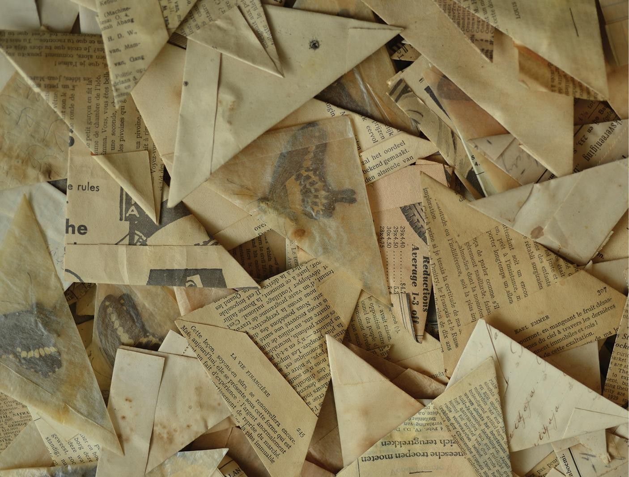
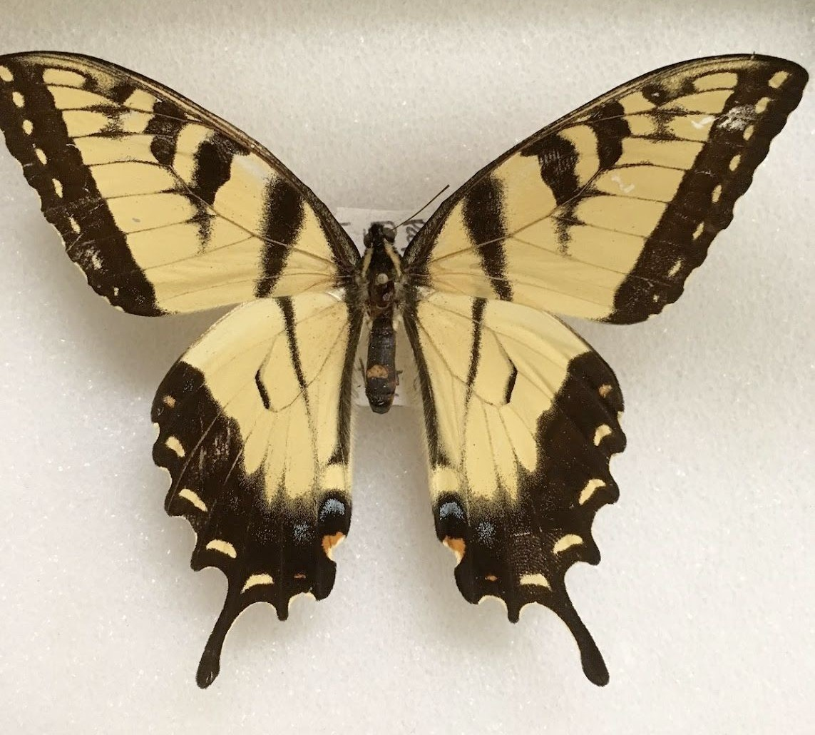
Examples of pre-digitization curation tasks
specimen preparation
Caspers M, Willemse L, Miracle EG, van Nieukerken EJ (2019) Butterflies in bags: permanent storage of Lepidoptera in glassine envelopes. Nota Lepidopterologica 42(1): 1-16. https://doi.org/10.3897/nl.42.28654
Chicago Academy of Sciences Entomology Collection
Brenda Nyaboke, Expert Workshop on GBIF Data Publication in Africa, ITCER, Kenya, 12.10.2023

Slide 6
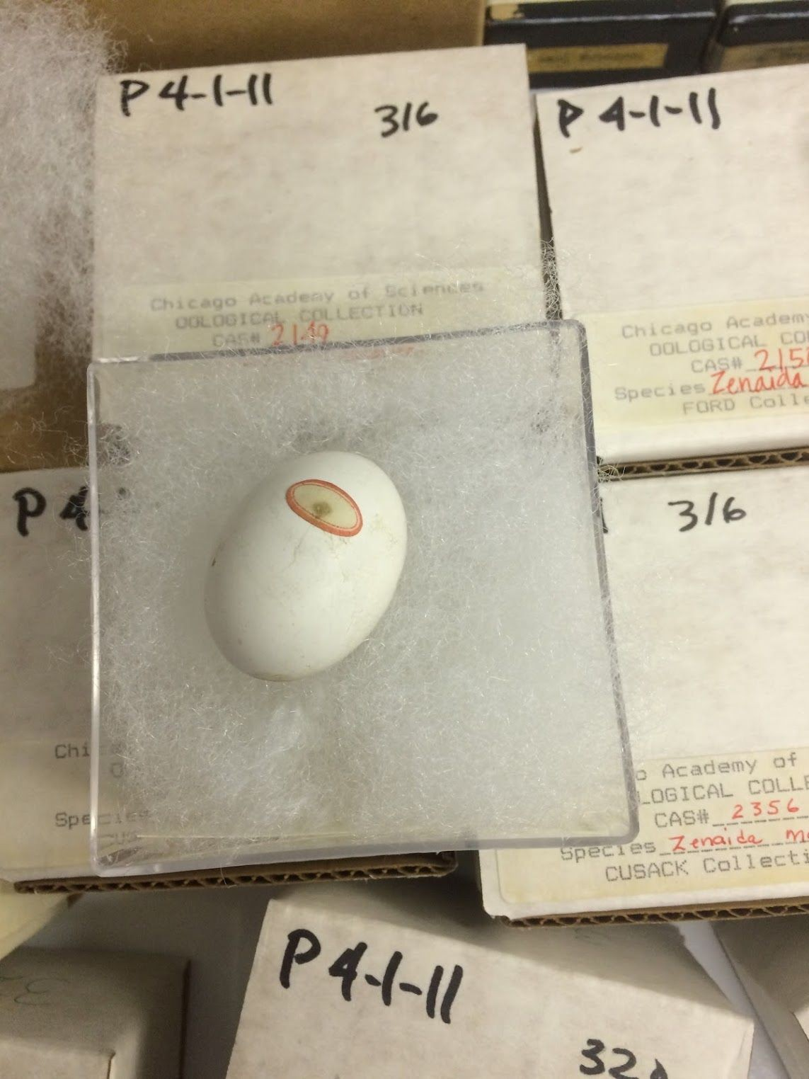
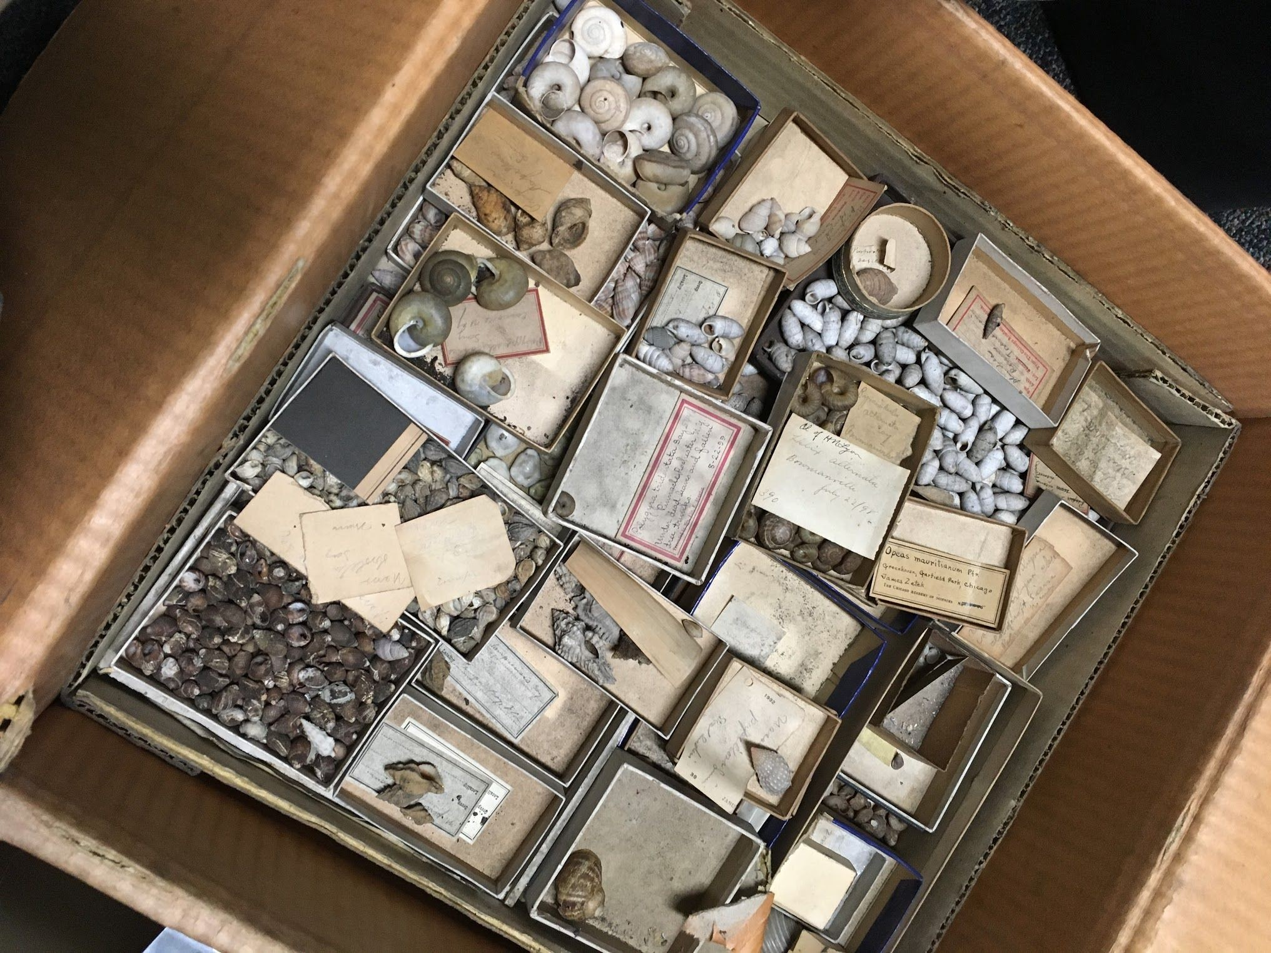
Examples of pre-digitization curation tasks
specimen repair and/or preservation
Chicago Academy of Sciences Malacology Collection
Chicago Academy of Sciences Oology Collection
Brenda Nyaboke, Expert Workshop on GBIF Data Publication in Africa, ITCER, Kenya, 12.10.2023

Slide 7
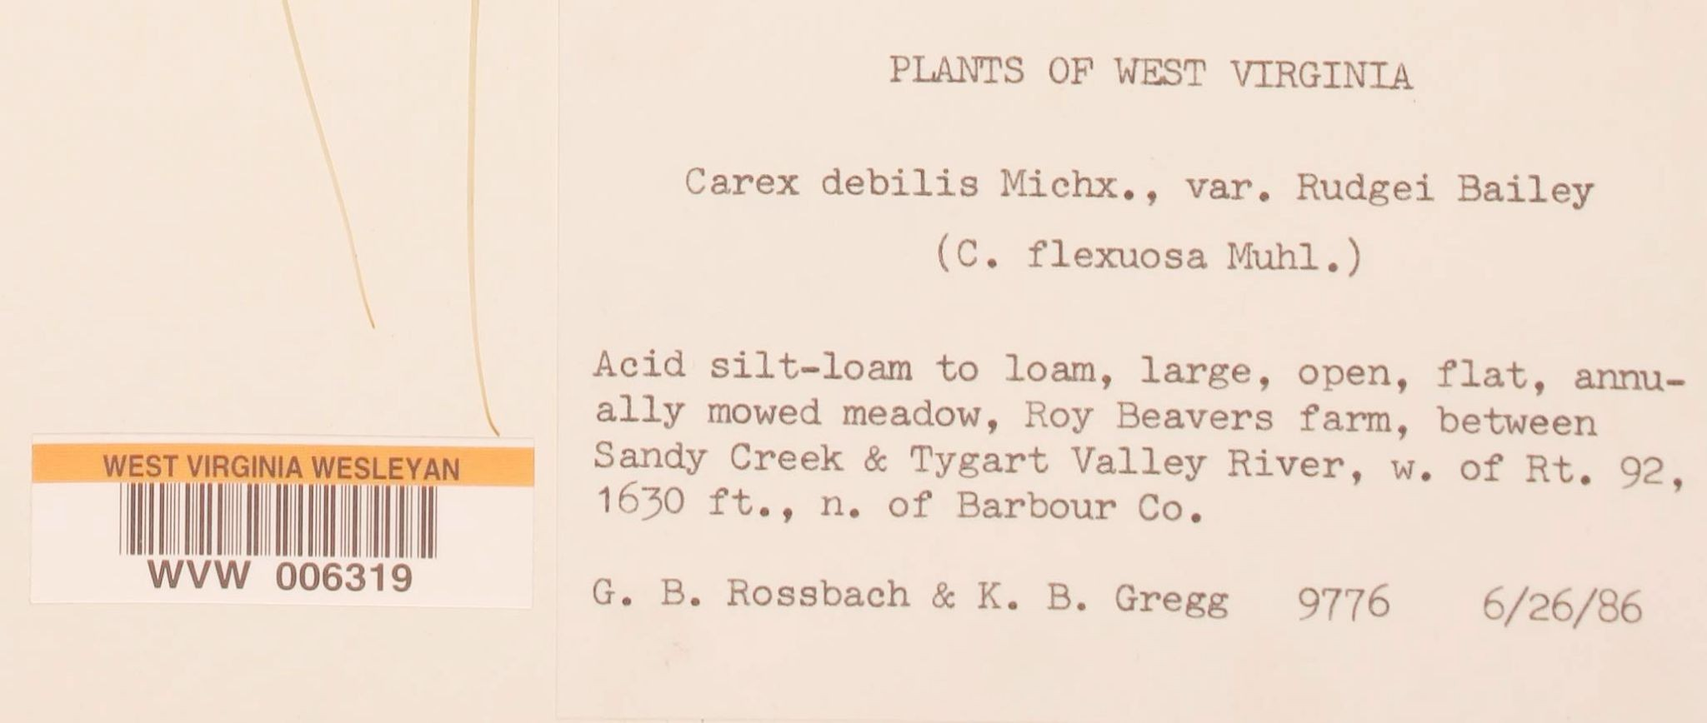
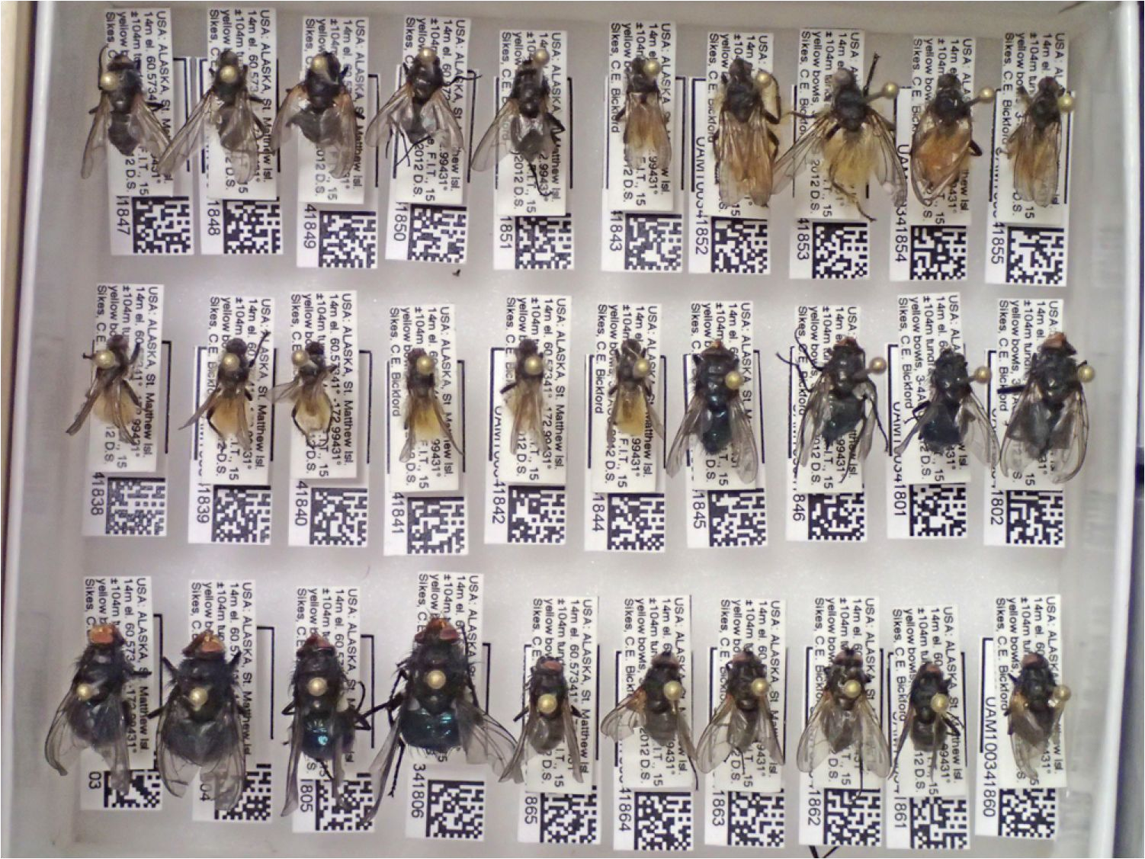
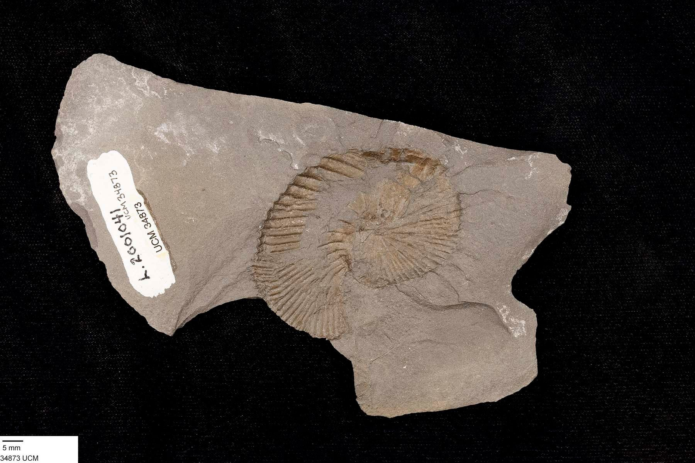
Examples of pre-digitization curation tasks
attaching unique identiﬁers
University of Colorado Museum of Natural History, Invertebrate Paleontology
University of Alaska Museum (UAM) barcoded flies
Brenda Nyaboke, Expert Workshop on GBIF Data Publication in Africa, ITCER, Kenya, 12.10.2023

Slide 8
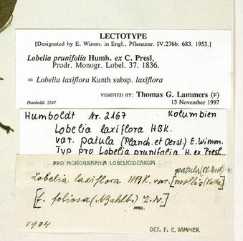
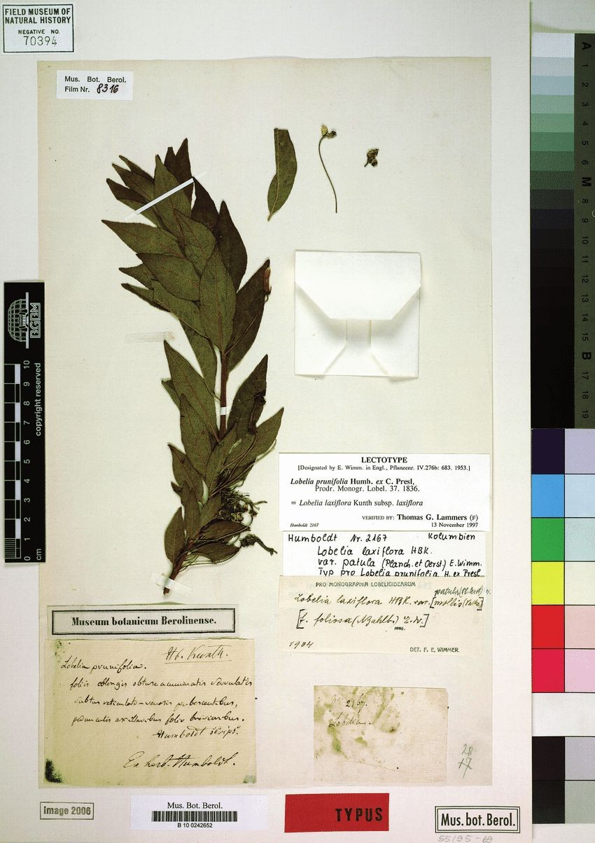
Examples of pre-digitization curation tasks
updating nomenclature
Güntsch, Anton & Berendsohn, Walter & Ciardelli, Pepe & Hahn, Andrea & Kusber, Wolf-Henning & Li, Jinling. (2009). Adding content to content – a generic annotation system for biodiversity data. Studi Trent. Sci. Nat. 84. 1123-128.
Brenda Nyaboke, Expert Workshop on GBIF Data Publication in Africa, ITCER, Kenya, 12.10.2023

Slide 9
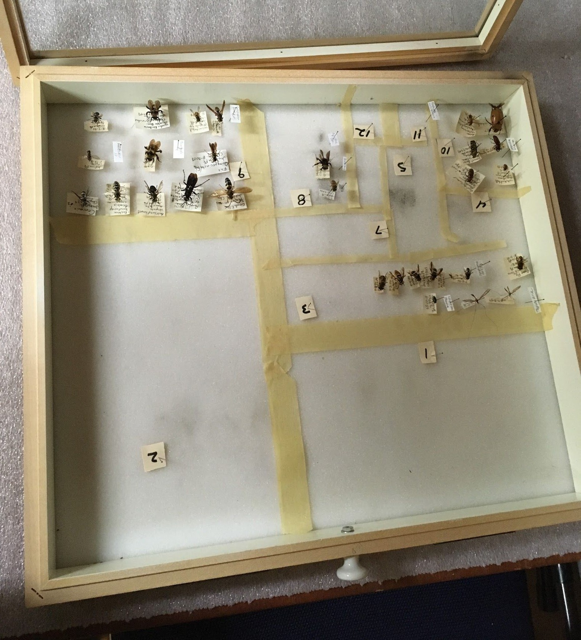
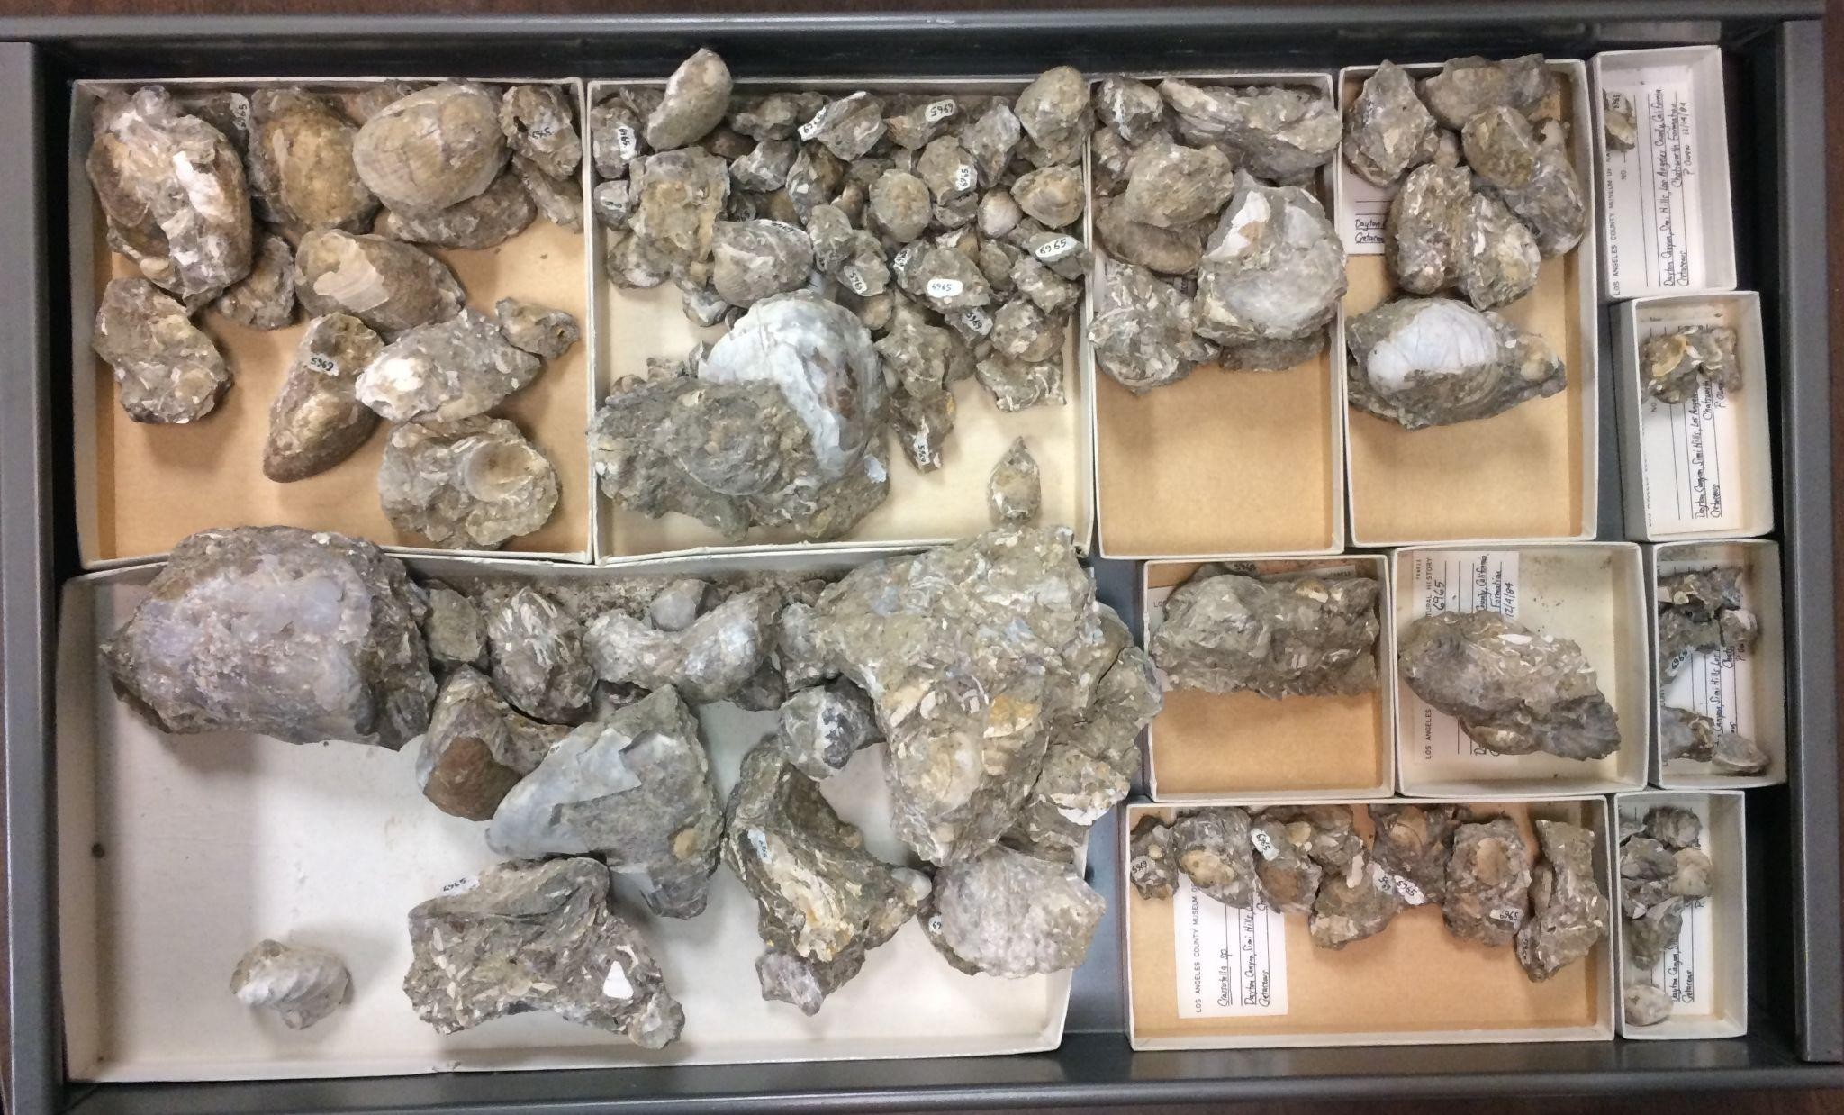
Examples of pre-digitization curation tasks
physical collection organization
Natural History Museum of Los Angeles Invertebrate Paleontology Collection
Chicago Academy of Sciences Entomology Collection
Brenda Nyaboke, Expert Workshop on GBIF Data Publication in Africa, ITCER, Kenya, 12.10.2023

Slide 10
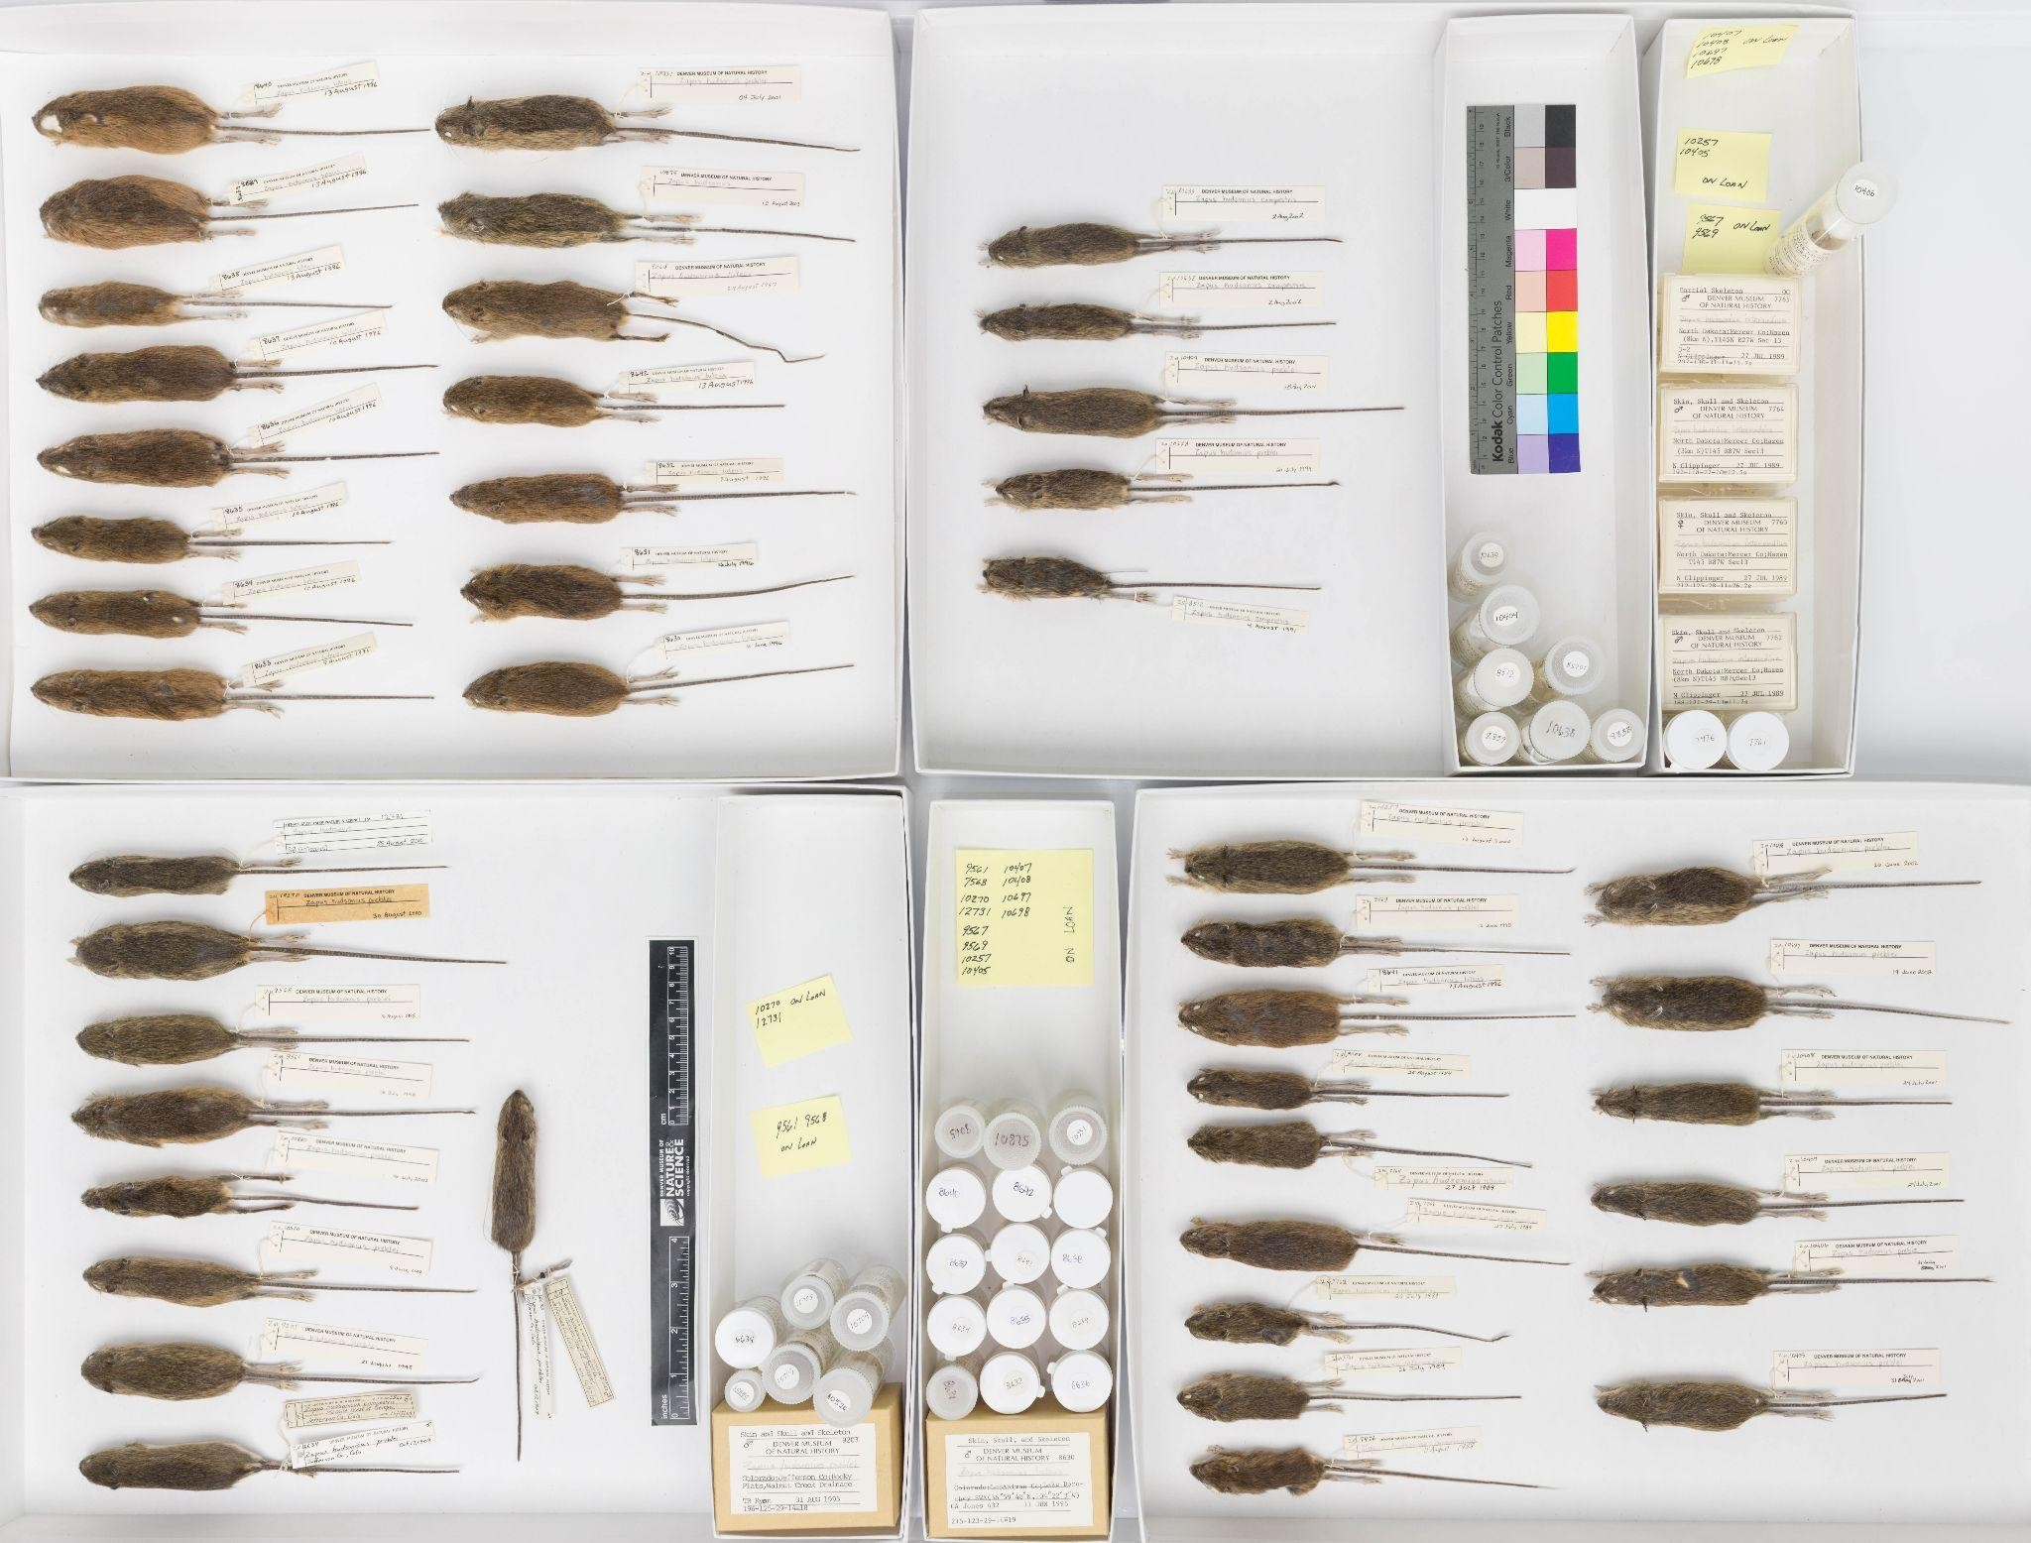
Examples of pre-digitization curation tasks
ﬂagging exemplar specimens
Denver Museum of Nature and Science Mammals Collection
Brenda Nyaboke, Expert Workshop on GBIF Data Publication in Africa, ITCER, Kenya, 12.10.2023

